Slide 1
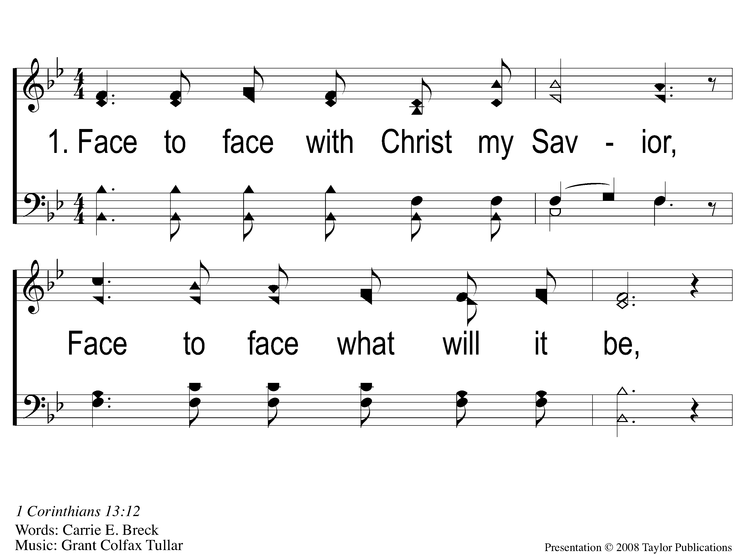
1-1 Face To Face
Face To Face
98

Slide 2
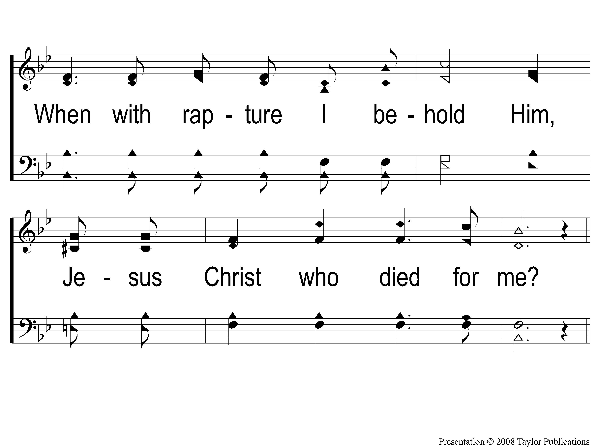
1-2 Face To Face
Face To Face
98

Slide 3
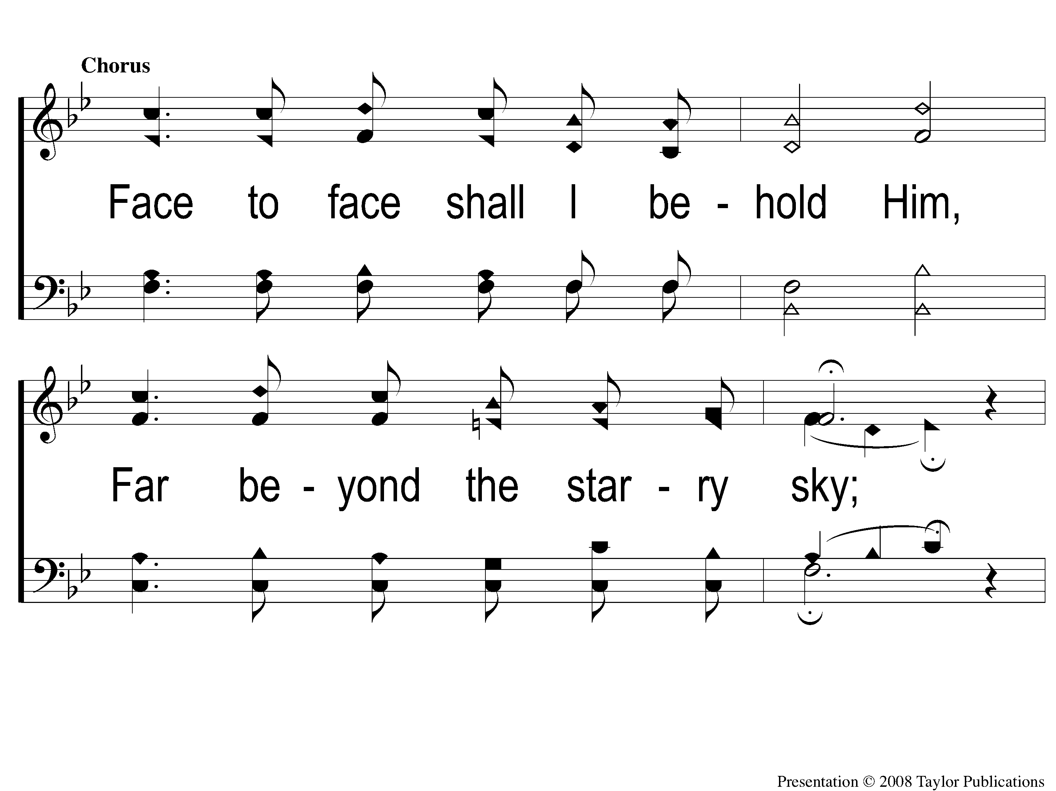
C-1 Face To Face
Face To Face
98

Slide 4
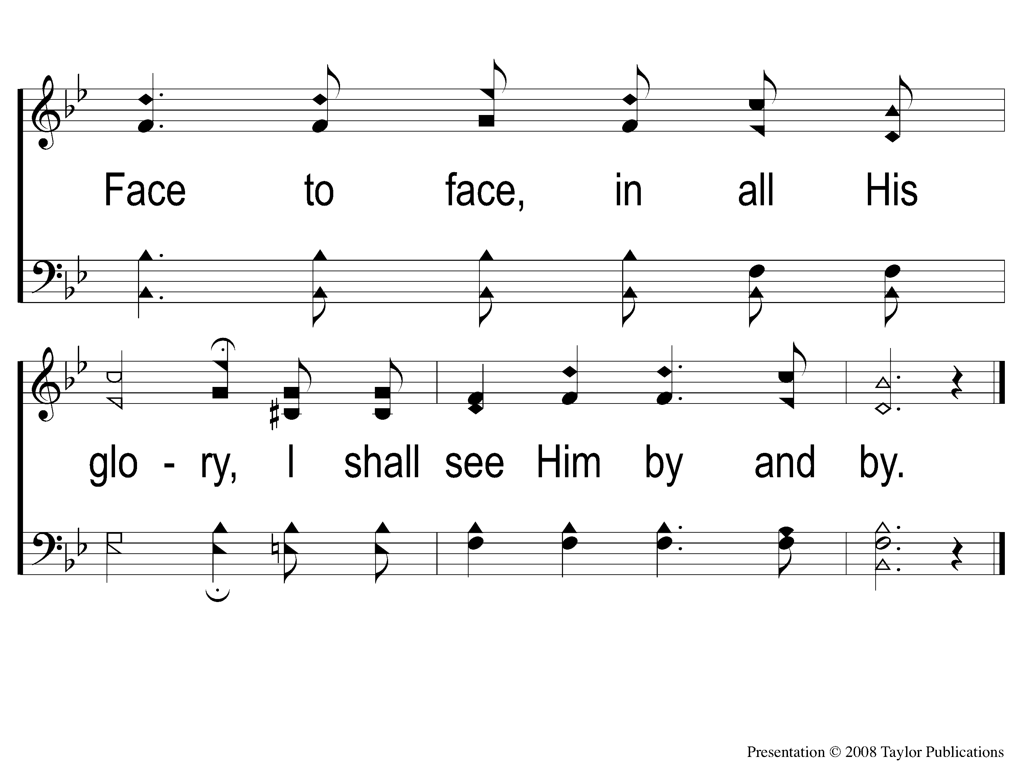
C-2 Face To Face
Face To Face
98

Slide 5
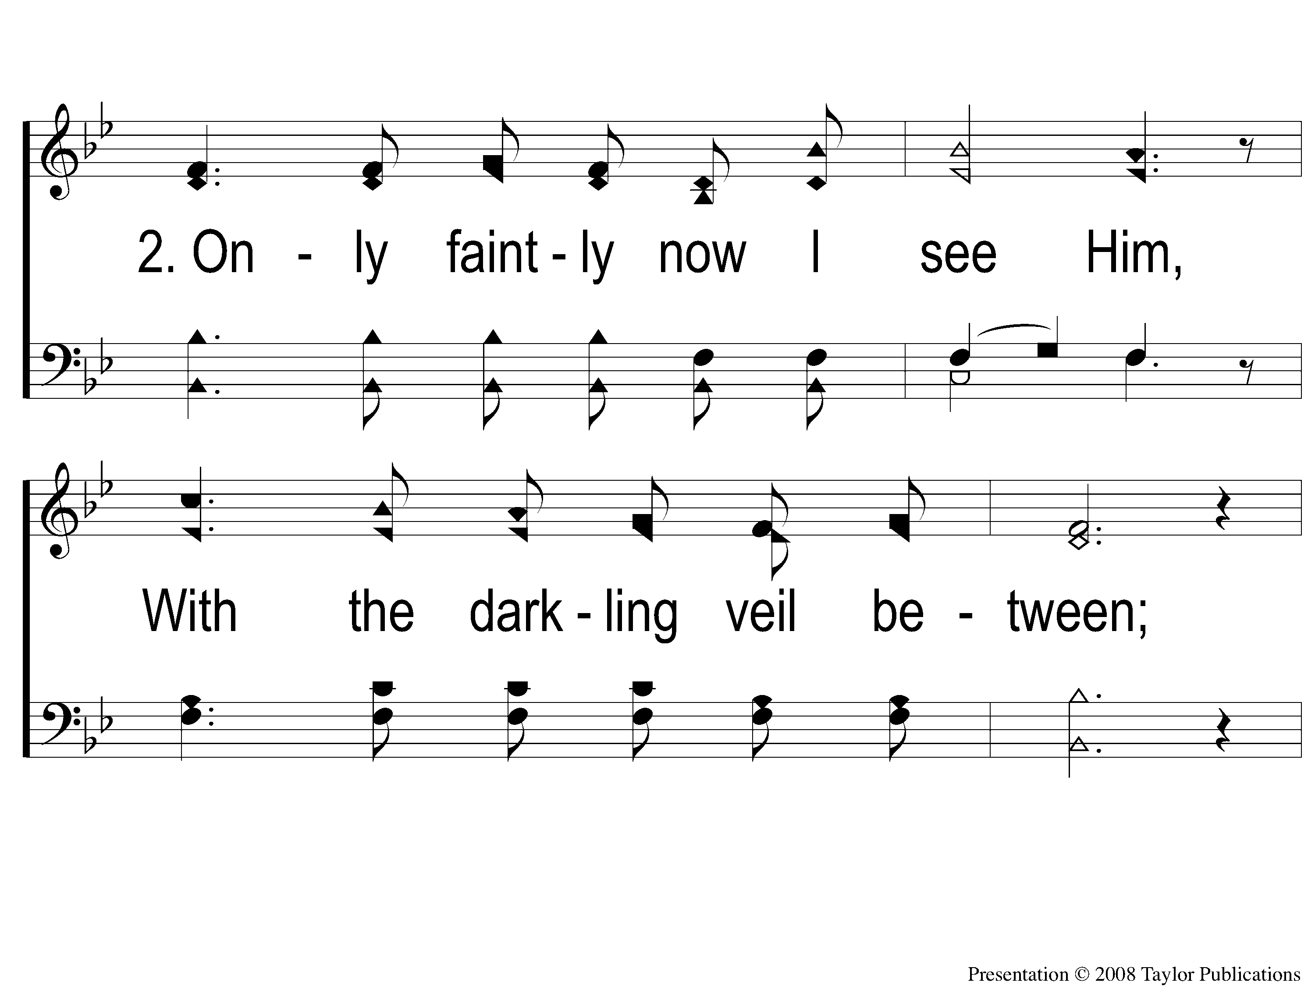
2-1 Face To Face
Face To Face
98

Slide 6
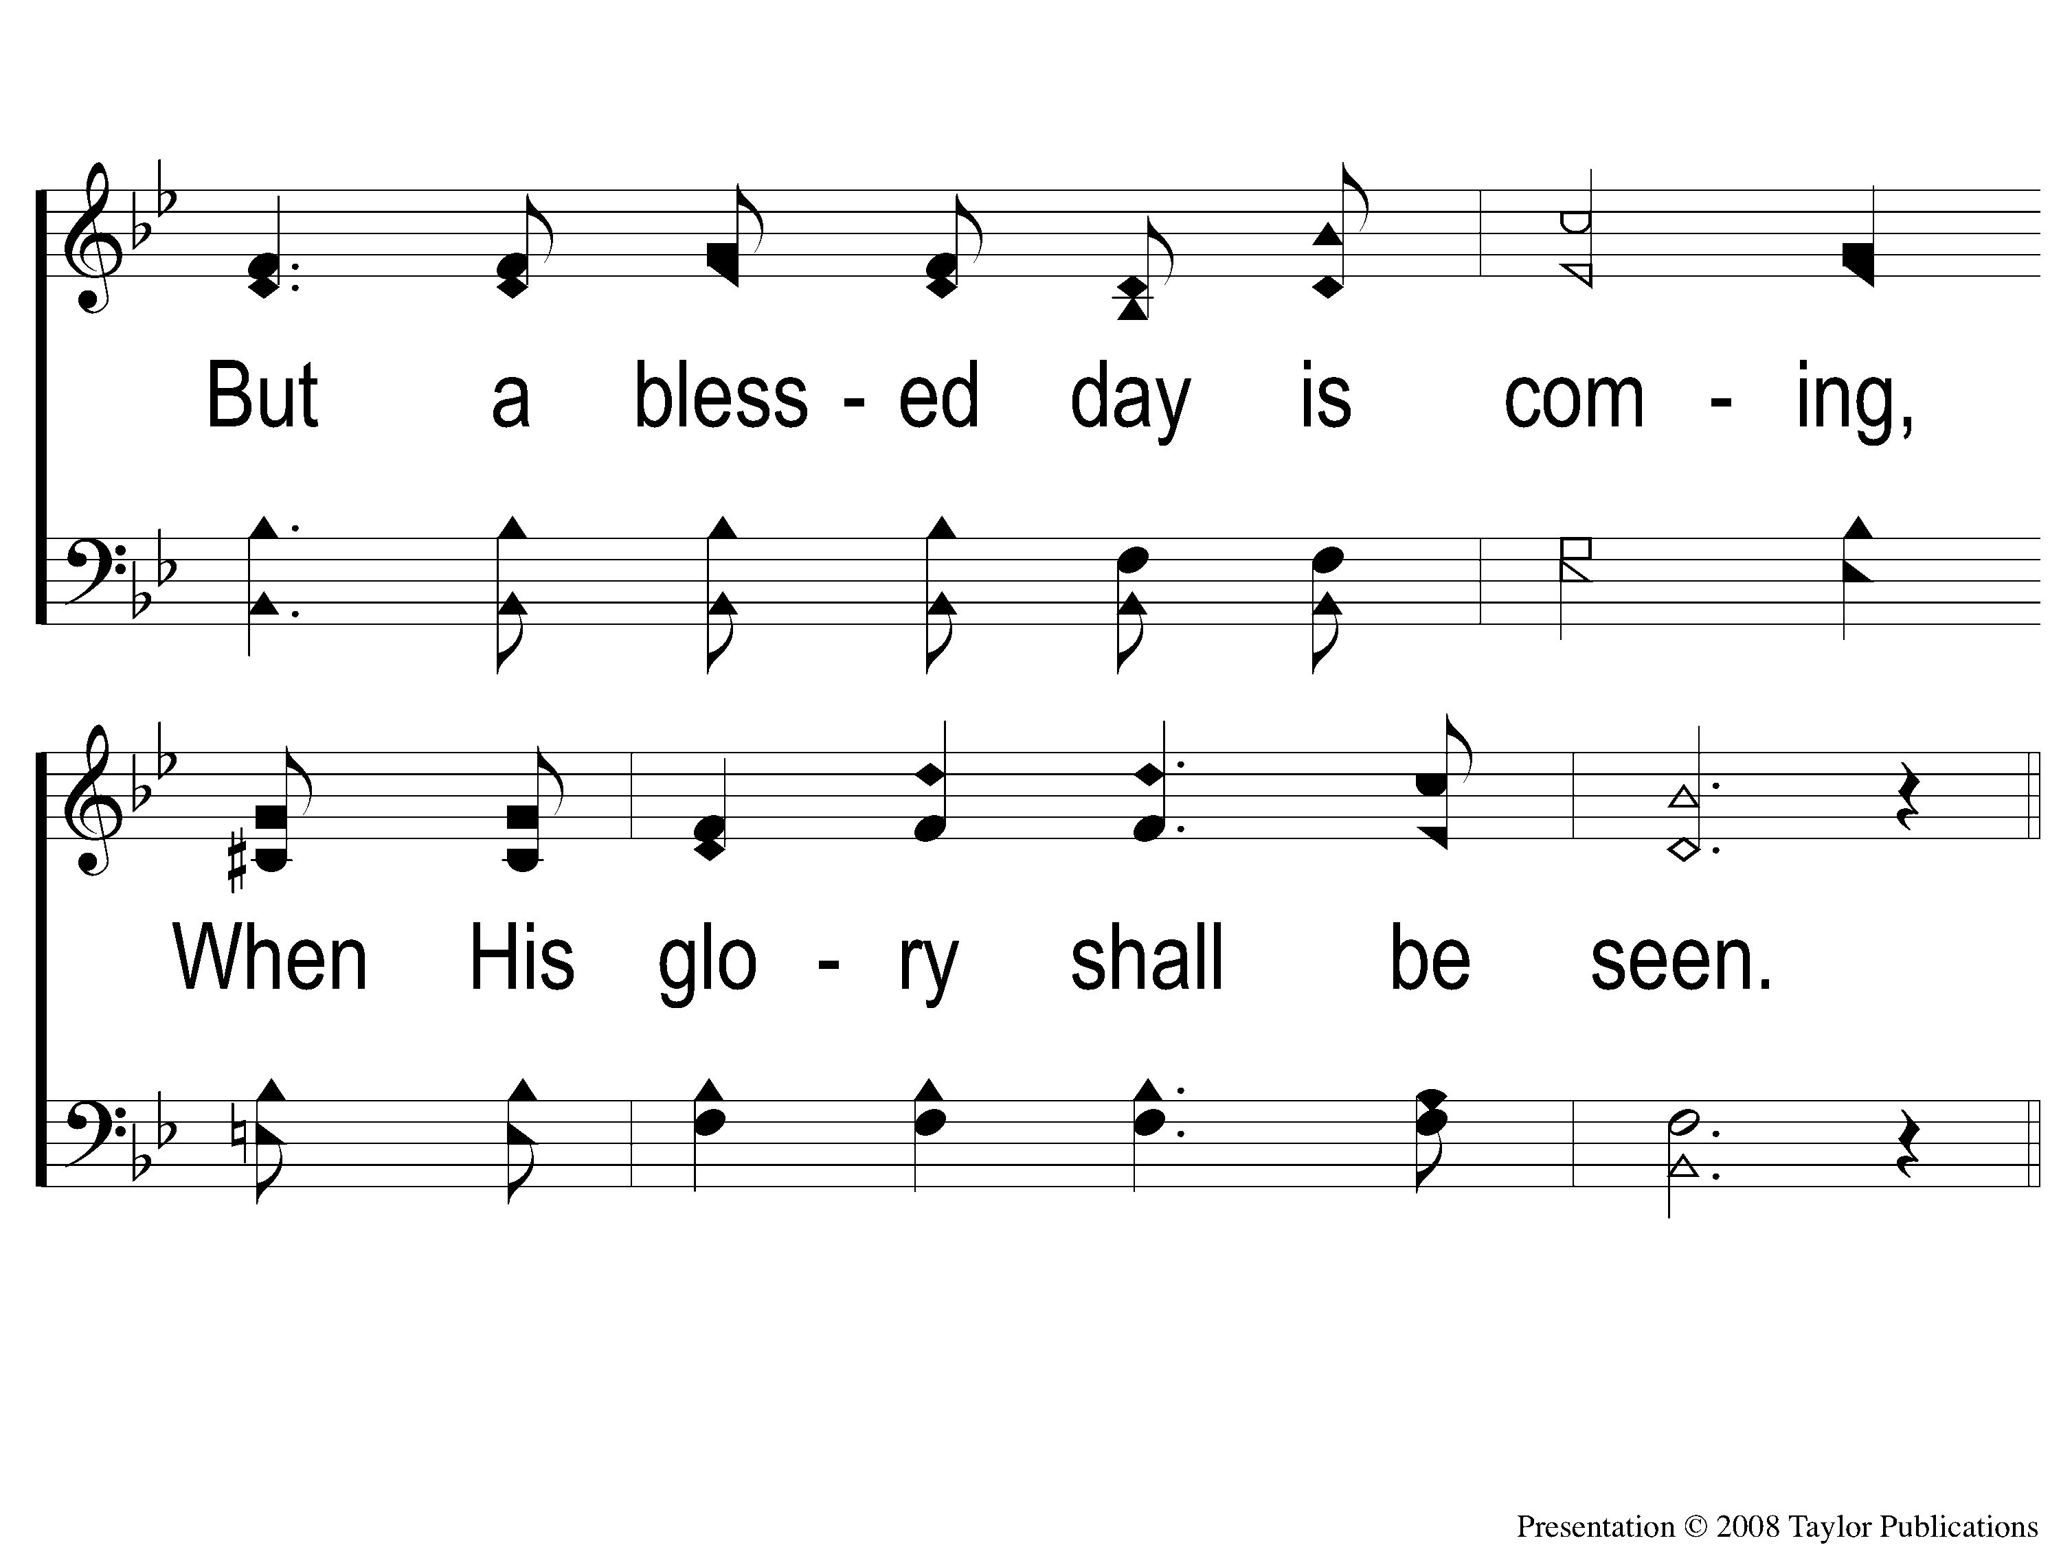
2-2 Face To Face
Face To Face
98

Slide 7
C-1 Face To Face
Face To Face
98

Slide 8
C-2 Face To Face
Face To Face
98

Slide 9
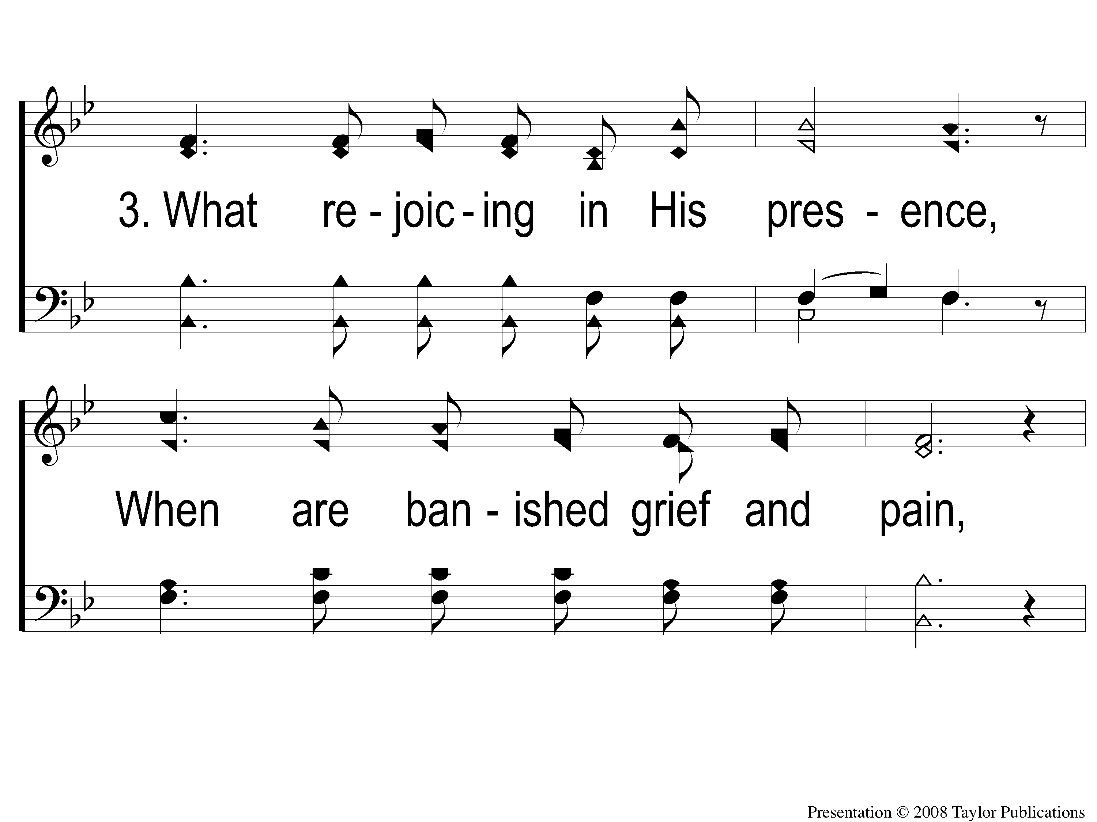
3-1 Face To Face
Face To Face
98

Slide 10
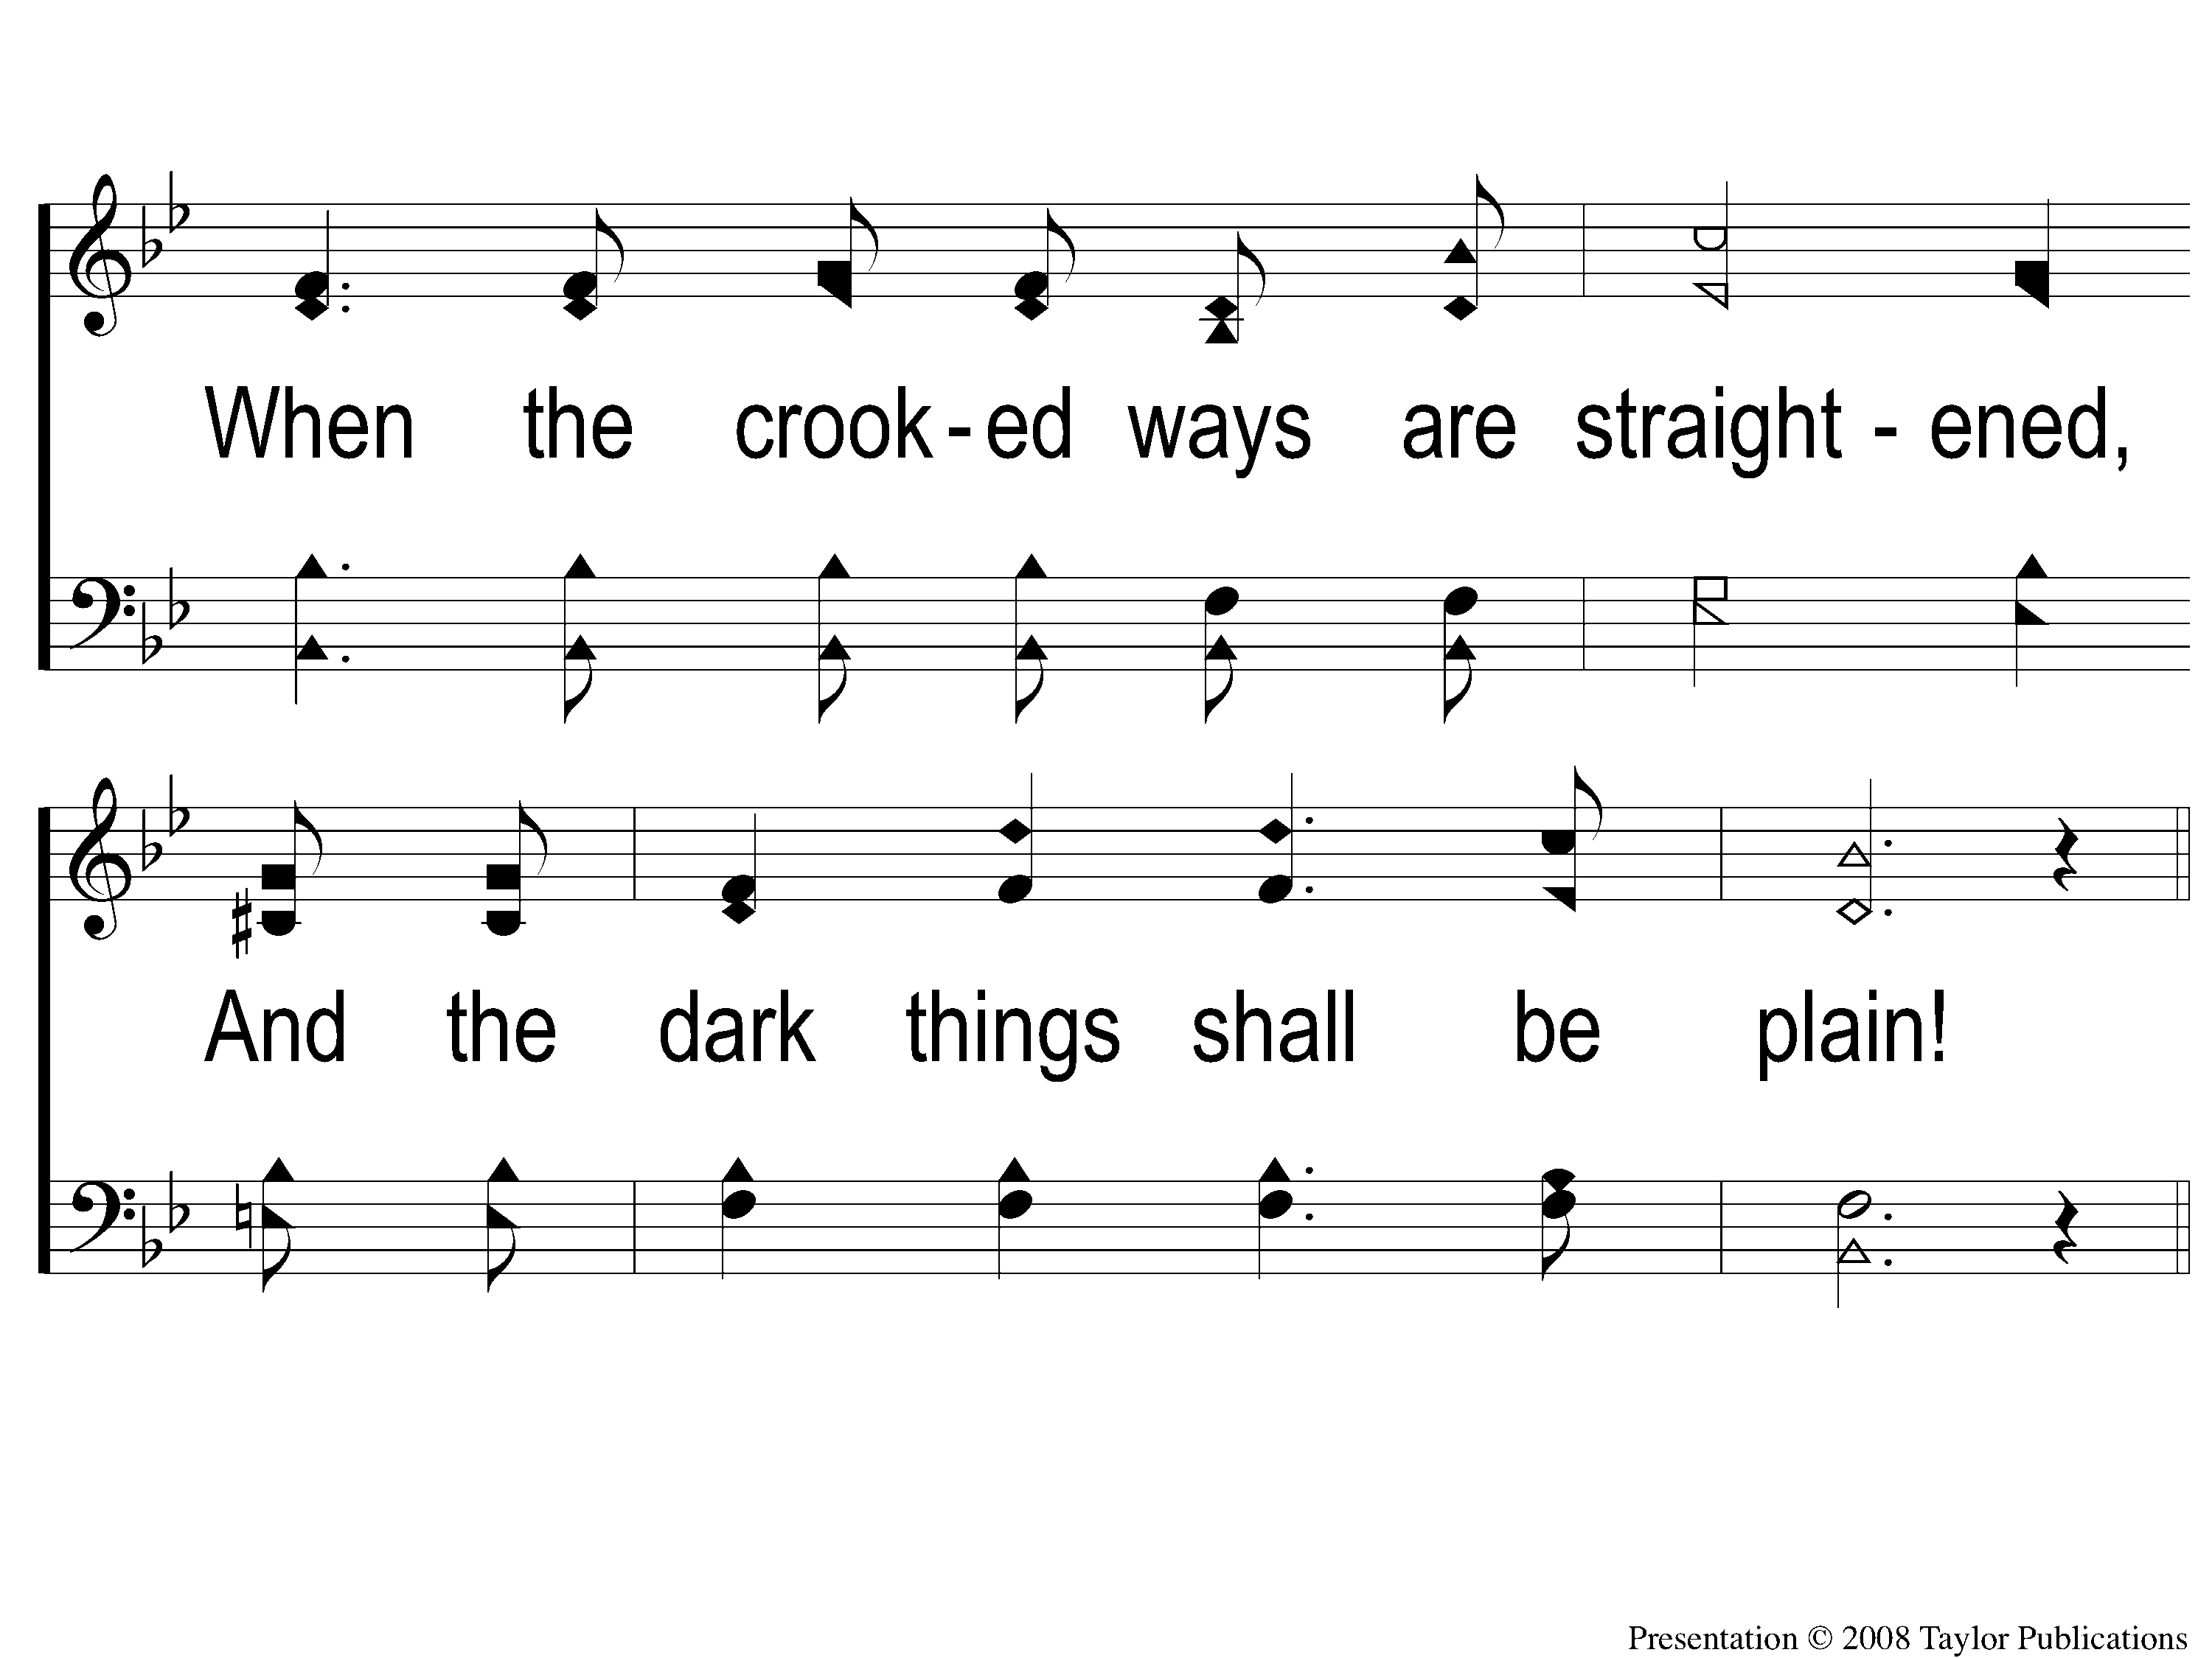
3-2 Face To Face
Face To Face
98

Slide 11
C-1 Face To Face
Face To Face
98

Slide 12
C-2 Face To Face
Face To Face
98

Slide 13
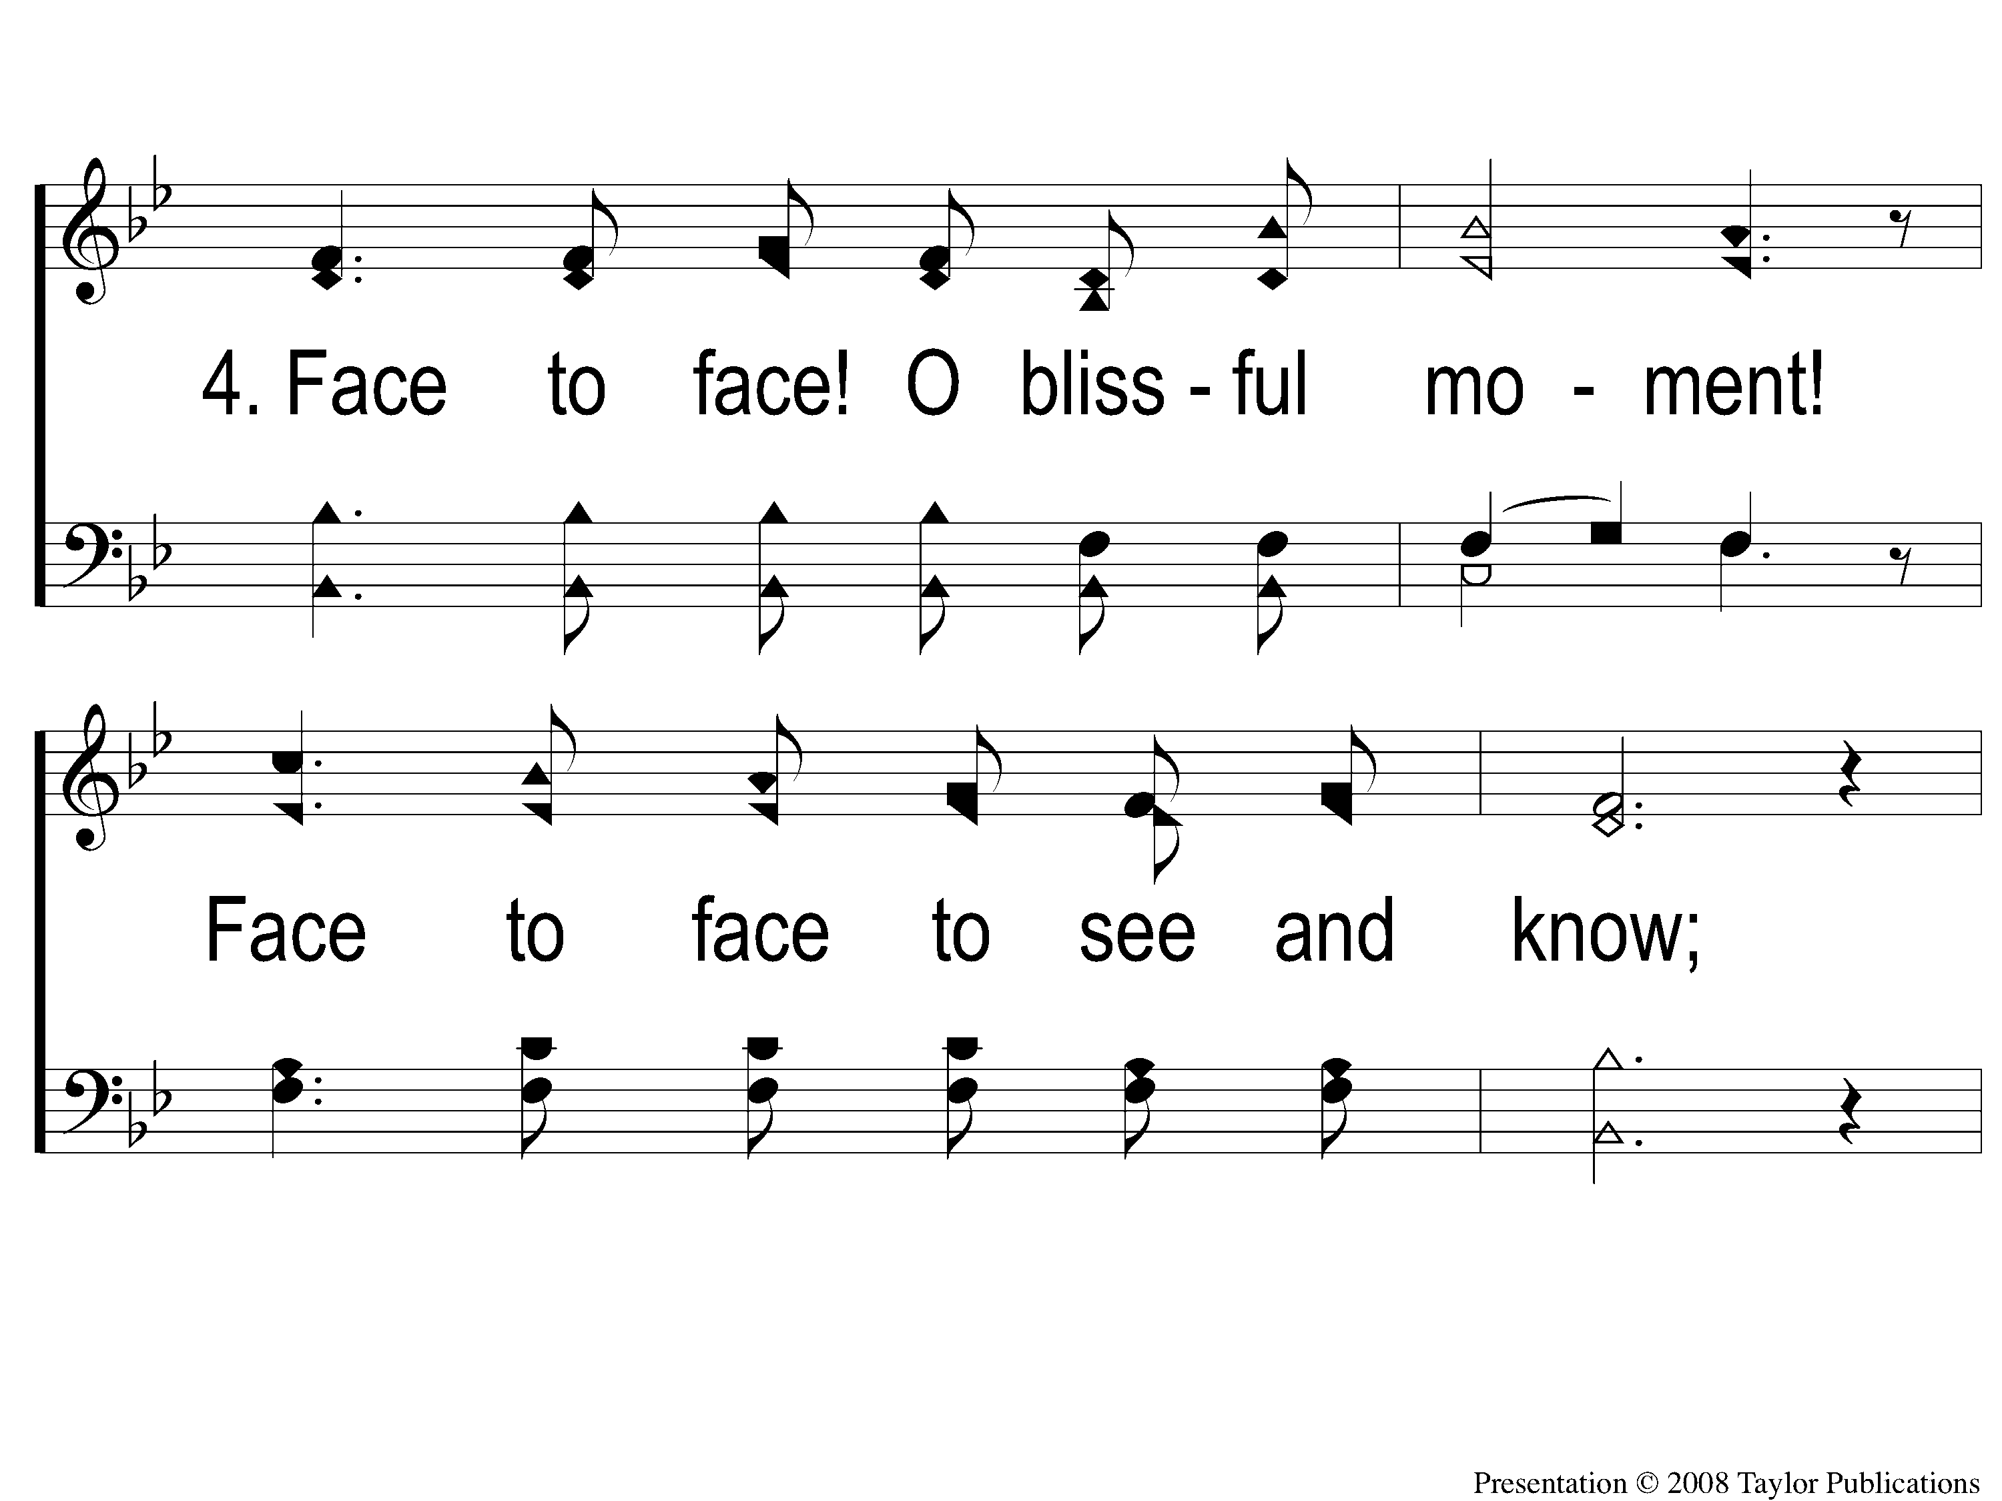
4-1 Face To Face
Face To Face
98

Slide 14
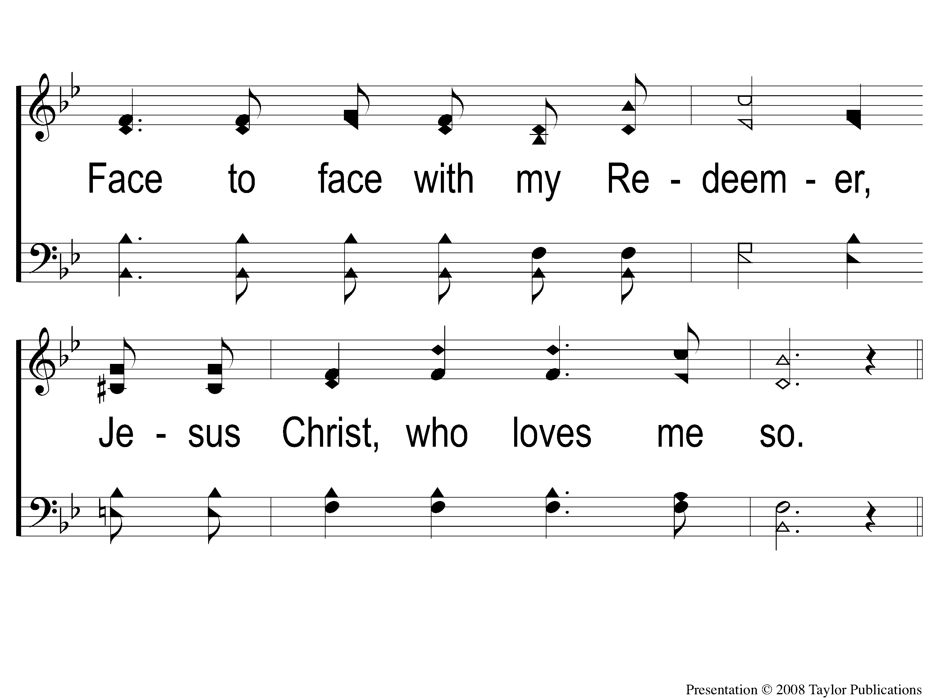
4-2 Face To Face
Face To Face
98

Slide 15
C-1 Face To Face
Face To Face
98

Slide 16
C-2 Face To Face
Face To Face
98

